Slide 1



Summer of 2021

Slide 2

Why Global Project?
Students need training
Gear up, not down, for summer
Prepare them for coming back in the fall to labor
Covid has spread us out so much
We put all the pieces together for you
More flexibility
You are the director of your project
Matthew 28 and Matthew 9—Jesus lays out the problem & the solution!
v

Slide 3
Five Themes for the Summer
Gaining God’s vision for your life
Building the right foundation for your life
Becoming a faithful witness for Christ
Beginning to disciple believers
Transforming into a World Changer
v

Slide 4
Project Components
1. Large group meeting (Project Director facilitates)
  Watch/listen to talks
  Small group discussion w/questions provided
  Worship, testimonies, announcements, etc…
2. Discipleship group meeting (D-group leader facilitates)
  Read/discuss chapters from Fuel and the Flame w/questions provided
  Prepare/discuss inductive bible study
  Recite memory verse
  Prayer/encouragement/accountabilities
3. Suggested additional weekly activities
  1 on 1 time w/each participant
  World Christian night (prayer for the world, mission mobilization talk, mission testimonial)
  Small group outreach (each participant starts a weekly group w/peers to practice recruiting/leading/witnessing)
  D-Group training night
v

Slide 5

Discipleship Groups (D-Groups)
You as project leaders manage and lead your D-Groups
Weekly Prep
  Read The Fuel and the Flame
  Utilize Inductive Bible Study method
D-Group Time
  Discuss The Fuel and the Flame
  Prayer and Accountability (outreach, stewarding time, purity)
  Bible study (facilitated discussion by D-Group leader)
v

Slide 6

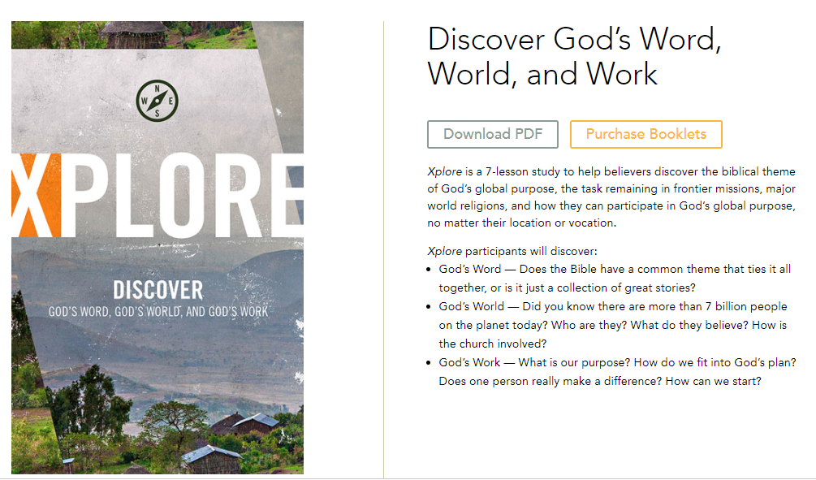
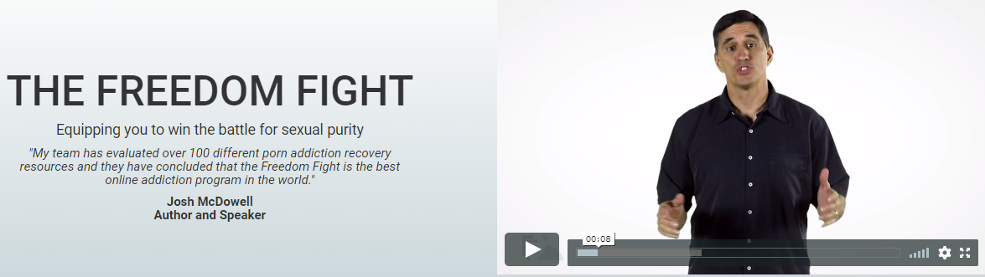
Outreach Initiative
Evangelism – 4 week study
Mission Mobilization – 7 week study
Purity Group – Freedom Fight’s
30 Day Challenge
v

Slide 7
Weekly Time Commitments for Participants
  Large Group meeting (90-120 minutes)
  D-Group meeting (120 minutes)
  D-Group meeting preparation (120 minutes for Bible Study and F&F reading)
  One on one (60 minutes)
Total (6.5-7 hours)
  Outreach initiative (120 minutes: 60 for prep and 60 for leading)
Grand Total (7.5 - 8.5 hours)
v

Slide 8
D-Group Leaders Role
Prepare:
  Pray that God would bring the right people into your group that you would help them grow closer to Christ this summer. Understand your staff’s expectations of you, and be well prepared each week to lead your D-Group discussions.
Recruit:
  Recruit to your Global Project and especially to your D-Group if your Project host has asked that of you. People will only say yes to this project if they are asked by someone.
Lead:
  Be a great facilitator of your D-Group meetings, not monopolizing the conversation. Your role is to help your participants discover what God is teaching them, not to preach to them.
  Schedule time to meet with each of your D-Group participants individually every week or every other week.
  Work with your project leader to determine goals for this time. Considering practicing the 5R Coaching Model — Relate, Reflect, Refocus, Resource, Review.

Slide 9
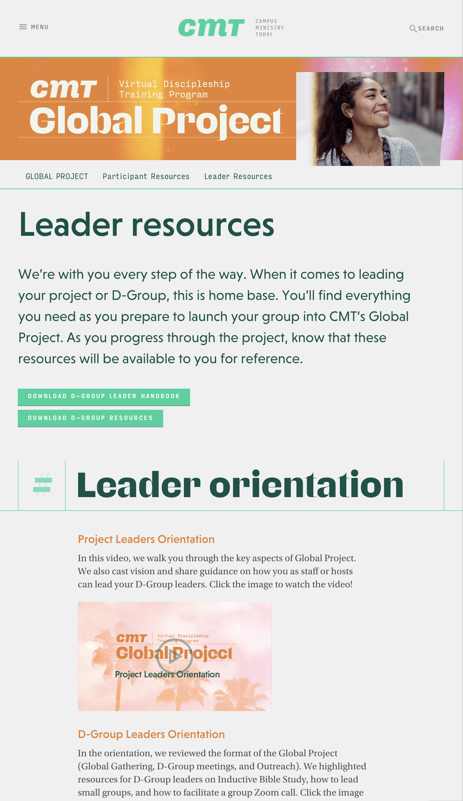
Go to our Global Project website for all D-Group Resources
Download The Fuel and the Flame
Download your D-Group Leaders Notebook
Watch and Download Inductive Bible Study resources and other leader resources
Prep the Outreach initiative, so you can explain it well

Slide 10
Global Project Team &
Set-up Process

Slide 11
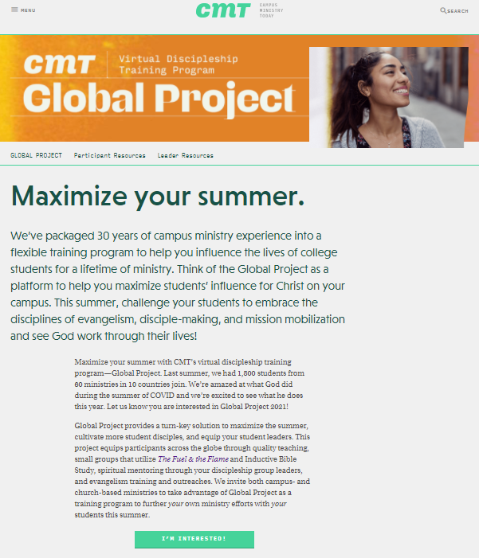
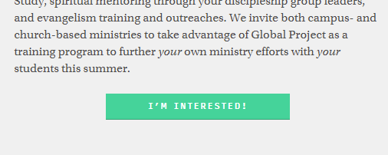
Step 1 – Interest Form
Fill out our Interest Form
Talk to Robert Ewing
Ensure you know all the details of what you do / what we do
Take the next step
v

Slide 12
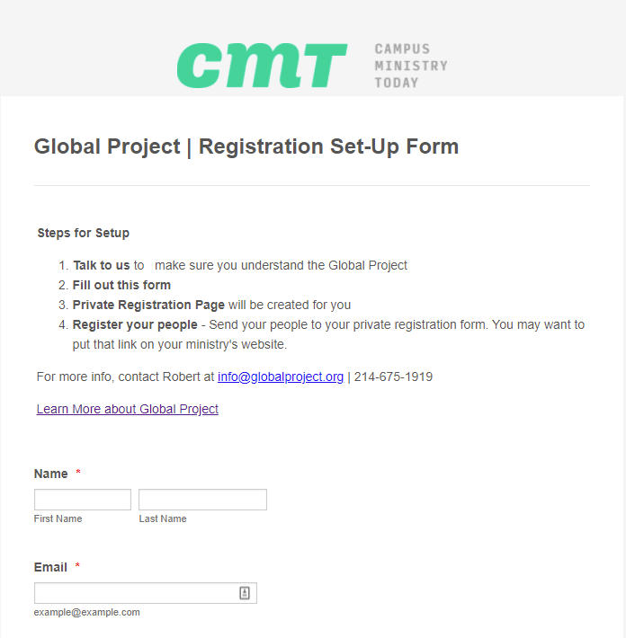
Step 2 – Registration Set-Up Form
Fill out Registration Set-Up Form
Corrie Selig will create a registration form for your group
v

Slide 13
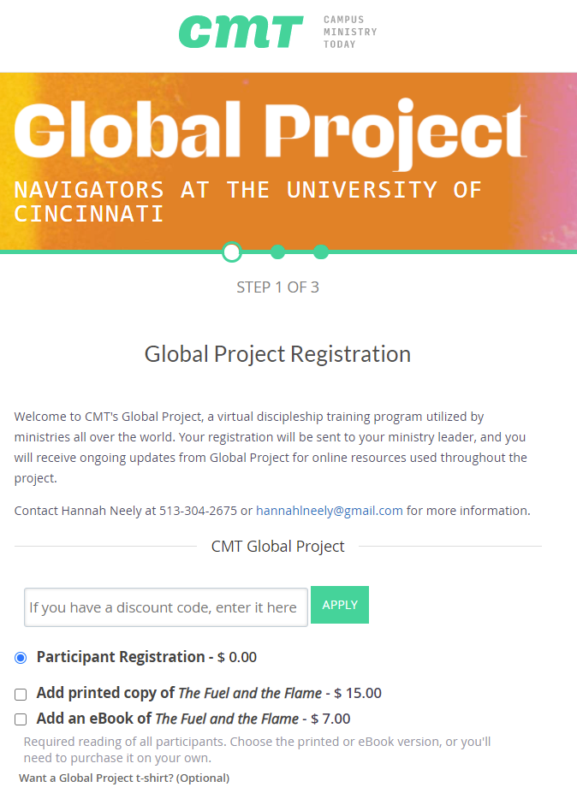
Step 3 – Start preparing and recruiting
Ensure your Registration form works well
Sign-up yourself and D-Group Leaders
Recruit and have students sign-up
Books – students can order or you can order in large quantities
v

Slide 14
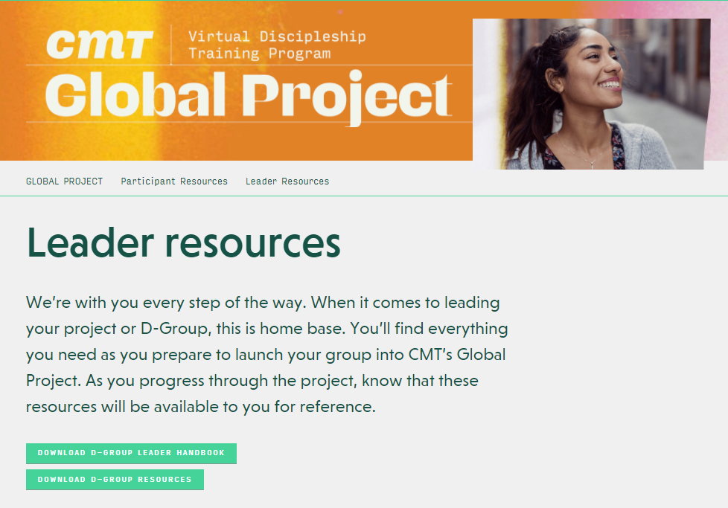
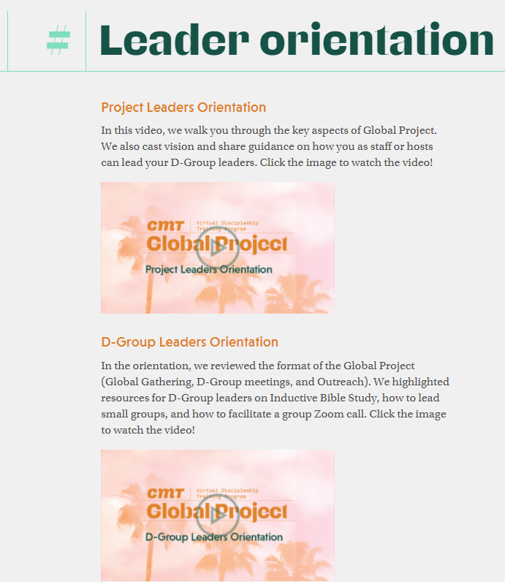
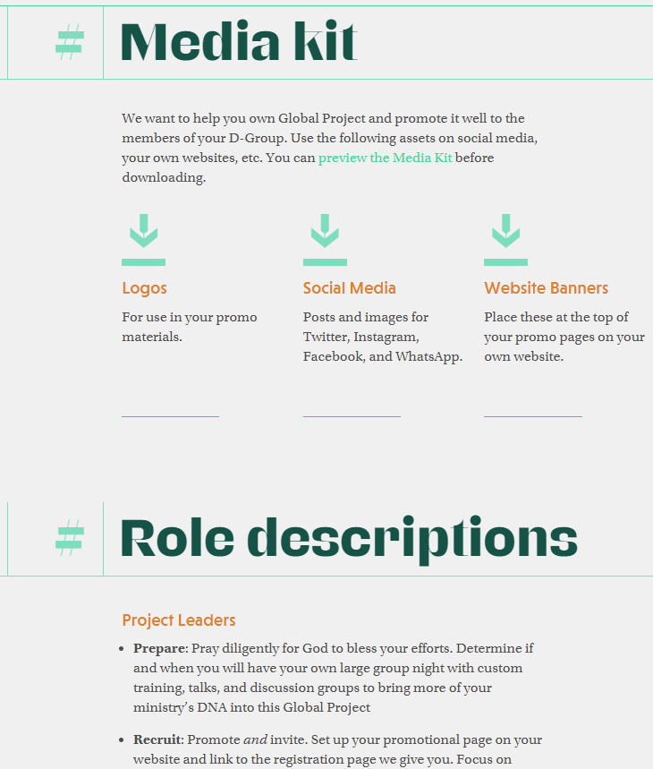
Step 4 – Project and D-Group Resources
v

